Slide 1

<EPAM> Training final project “JCasino Slots”

Slide 2

Application features
Player:
Registration, login/logout;
3-step identity verification;
Technical support questions;
Edit profile;
View stats;
View account data;
Replenish/withdraw money, take loan;
View operation history;
Play slots…

Slide 3
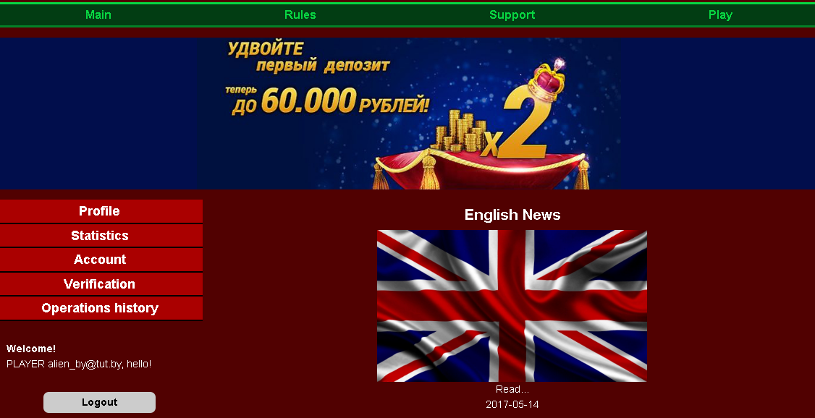
Player interface

Slide 4

Application features
Admin:
Login/logout;
Add/edit/delete news;
Verify player (with comments);
View technical support questions and answer them;
View player operation history;
View player data;
Change player status (with comments).

Slide 5
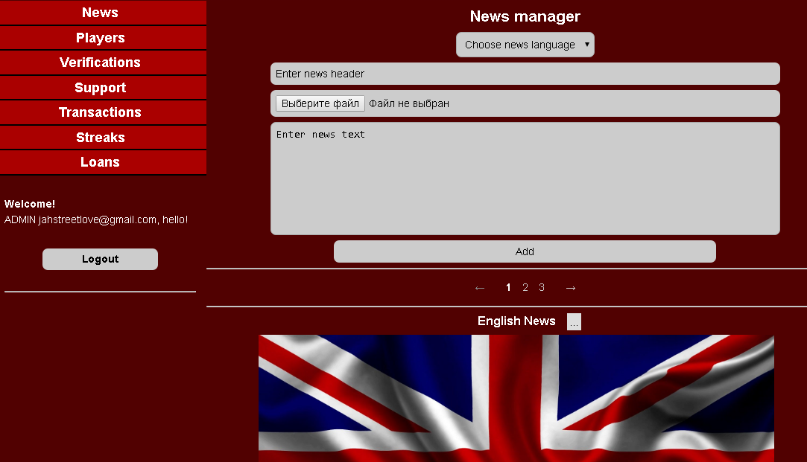
Admin interface

Slide 6
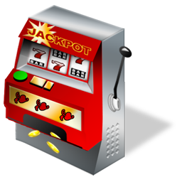
Application features
Game:
View/choose playing lines;
Choose bet amount;
Choose each reel offset;
Finish streak;
View player operation history;
Turn on/off music;
“Demo” and “For real money” play modes.

Slide 7
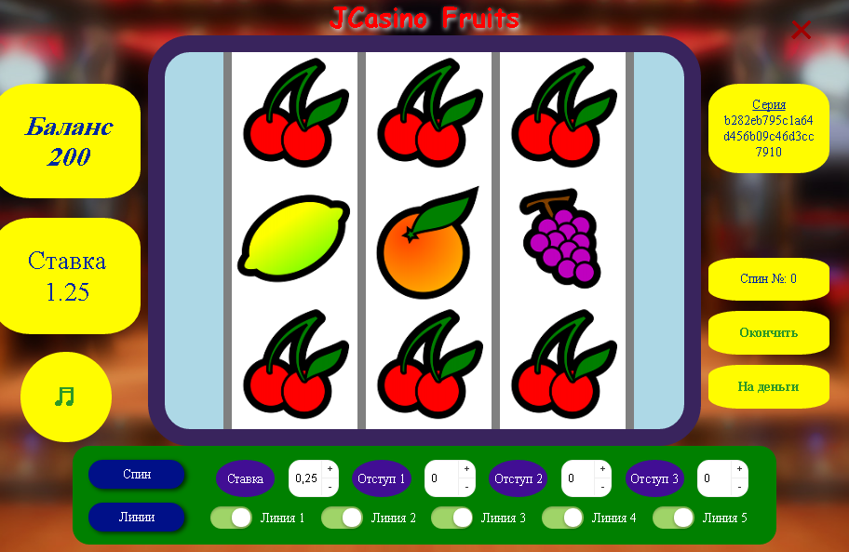
Game interface

Slide 8

Application features
Security:
User role control;
Page update scenario control;
Custom user navigation prevention;
SQL injection protection;
JavaScript injection protection;
Other security features.

Slide 9

Application features
Common:
Multi-language content and message support (Ru/En);
News feed;
Pagination support;
Support for mobile devices with small screens.

Slide 10
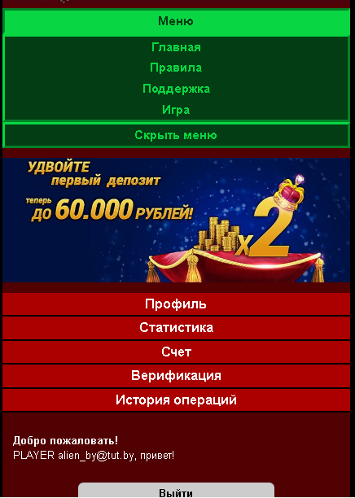
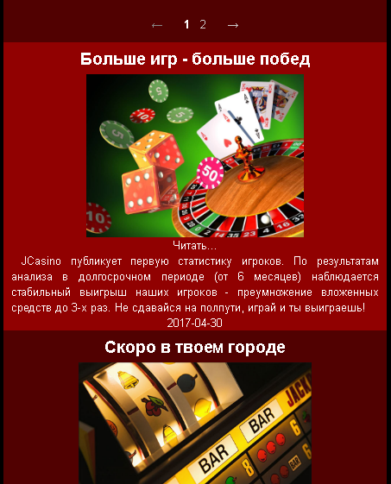
Mobile interface

Slide 11



Used technologies
Application architecture: Client – Server – DB.
Request
Response
SQL query
Client (Web Browser)
Tomcat App Server
MySQL RDMS

Slide 12
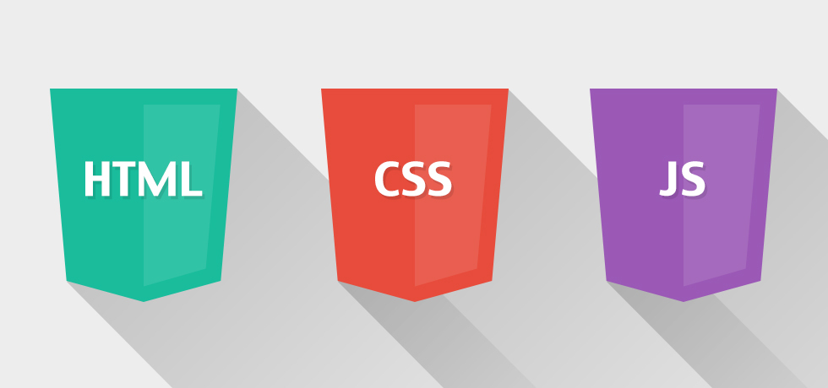
Used technologies
Front-end:
Pure HTML5, CSSS3, JavaScript, Flexbox responsive design;
jQuery plugins;
jPages pagination and some other small JS libraries;
Game engine using AJAX, Canvas animation, JS;
Form validation.

Slide 13


Used technologies
Database:
MySQL RDMS;
JDBC database access;
Self-written singleton connection pool;
Stored SQL procedures.

Slide 14
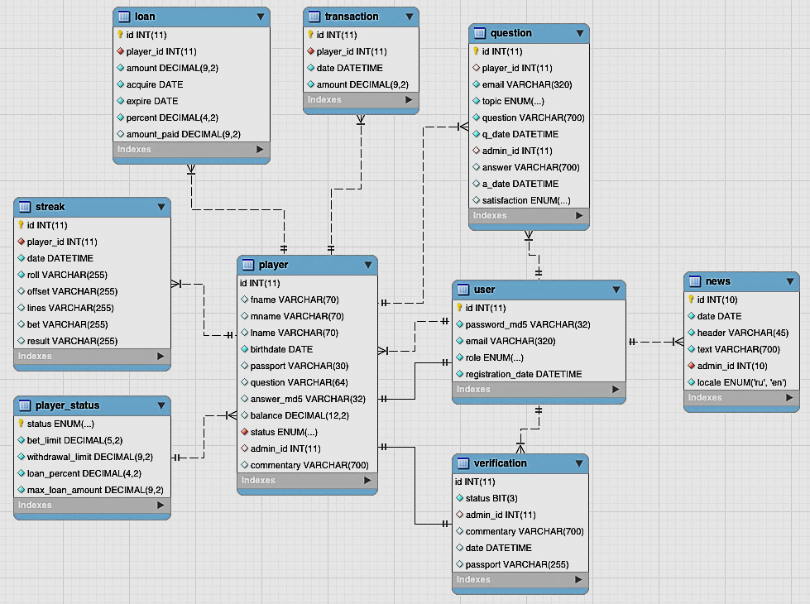
Database structure

Slide 15





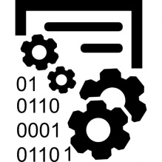

Server-side model
Application Server
Command
Service
Connection Pool
Retrieve and validate request params, process request data
Take connection
Servlet Container
Execute command to take navigation data
Process business logic, modify data for database call
Filters
Controller
DAO
Listeners
Database call, process queries
Request
Response
MySQL RDMS

Slide 16


Used technologies
Server-side:
Tomcat Application Server;
Servlet&JSP (JSTL, EL, WebFilter, WebListener);
Java 8 features;
Java Mail;
Third-party Java libraries;
Request parameters validation.

Slide 17


Used technologies
Other:
Intellij IDEA;
Log4j2;
Maven;
Local and remote deployment setup (Jelastic platform);
Git;
JavaDoc;
Fail-safe and scalability features.

Slide 18


Used technologies
Test:
Junit 4;
Mockito, PowerMockito;
DBUnit;
Code coverage tools.

Slide 19
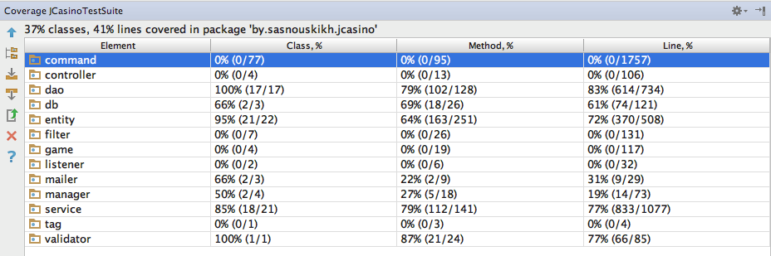
Test code coverage

Slide 20

Used design patterns
Singleton (Connection pool);
Builder and Factory (Command factory);
Wrapper (Wrapped connection);
Chain of responsibility (WebFilters);
Observer (WebListeners);
DAO;
Command;
MVC Layered architecture;
Lazy initialization (DAOHelper#getDAOinstance);
PRG (Navigation/F5-protection);
ACID transaction system (database transactions);
Common GRASP patterns;
Other.

Slide 21

Hire me NOW!
Phone: +375 (33) 653-21-15 (Aliaksandr)
E-mail: jahstreetlove@gmail.com
Skype: cocha_tz
VK: http://vk.com/id19015905
GitHub: https://github.com/jahstreet/JCasino
BitBucket: https://bitbucket.org/jahstreet/jcasino/src
Deployed project: http://jcasino.mycloud.by/
Want to make your team even stronger – just call me;)

